Slide 1

Sets Project
By: 0xc0

Slide 2
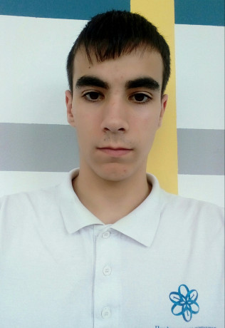



Our team
Тодор Божинов-Front end
Калоян Димов-Scrum master
Иво Димов- C++ Developer
Георги Георгиев- Code Checker

Slide 3

Our purpose
The code is developed for educational and entertaining purposes.

Slide 4




Technologies used
We used C++ to create the functions for our program, GitHub to collaborate, MS PowerPoint for our presentation and MS Word for our documentation.

Slide 5
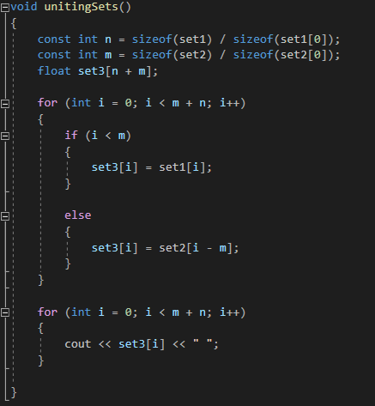
About our code
Our code is made up of five functions:
Users' input
Uniting two sets
Subsets
Section
Distinction

Slide 6
In the future
In the future we're planning to optimize our functions and to expand them.​

Slide 7


